Slide 1
Customer Segmentation using RFM Analysis and K-Means Clustering
By Group 03:
Ruchika Gupta | 200559617
Bhavesh Natwarlal Waghela | 200532173
Deema Sami Barham Al Dogom | 200548717
Ashtha Ravikant Parmar | 200537002
Navid Saleh Sadik | 200544271
Olalekan Apantaku | 200560337

Slide 2
Agenda
Problem and Objective
Technical Approach
Data Cleaning
EDA - RFM Analysis
K-Means Clustering
Outcome & Business Suggestions

Slide 3
Problem Statement
The primary purpose of this project is to perform customer segmentation utilizing the RFM (Recency, Frequency, Monetary) approach. The project aims to analyze customer transaction data and categorize customers into distinct segments based on their purchase behaviors and interactions with the business.
Data with following information is given for the purpose:
537979 transactions from 24928 Unique Invoices generated.
For 381 Unique days of Transaction from 02nd of Dec 2016 to 19th of Dec 2017.
Transacted by 4349 Unique Customers (Excluding blank).
For 3898 / 4009 Unique items shipped from 21 Unique locations.
Of total transaction Value of INR 116.27 Cr.

Slide 4
Technical Approach
To Create customer segments by understanding their purchase behaviour via RFM approach for an online retail business.
Following algorithms has been used to meet the objective of Customer segmentation:
RFM-Analysis - RFM (Recency Frequency Monetary) analysis or RFM segmentation is an effective marketing technique to identify customers for making decisions and strategies on marketing, product promotion, rewards for retention, incentives for more purchase, trial product etc.
All such activities incur cost and company’s objectives are to maximize return on expenses. Hence decision making after identifying right customers is an effective approach towards meeting the goal of maximizing benefits.
In RFM approach, we identify the following:
Recency (R) — How recently has each customer purchased? This is done by counting no of days between customer’s last purchase date and a reference date, greater than or equal to last available transaction date in data. We have considered the max date available in data for calculation of Recency value.
Frequency (F) — How often does each customer purchases? This is done by counting unique purchases of customers in a time span. The time span taken in our analysis is time span of data, i.e. 02nd of December 2016 to 19th of December 2017.
Monetary (M) — How much do they spend? This is summing total of Revenue generated from each customer in time span of data.
After calculating each of RFM Scores, the scores are labeled by various methods and intervals, depending upon company’s objective for the analysis. These labels are then combined, and customers are grouped in segments as per combination of labels and business strategies are framed for each segment.

Slide 5
Technical Approach
We have followed both conventional EDA and data science clustering model method for finding / deciding the segments.
K- Mean Clustering Algorithm for Unsupervised Learning – K-mean Clustering Algorithm clusters the data points into K partitions. K refers to number of k initial centroids / clusters, to which each observation / data point is iteratively allocated by method of minimized Euclidian distance of the data point from cluster centroids, until each data point is allocated to a cluster.
Elbow Method – K-Mean method requires an initial number K to be fed in model as number of desired clusters. Elbow method helps identifying the optimal / right number of K for the dataset. This method runs K-mean clustering for a set of K, say from 1 to 10 and distortion score (WCSS) is calculated for each model with 1 to 10 clusters. The score is plotted to visually find the point of inflection to decide the optimal number of clusters for data.

Slide 6
EDA Summary – Data Cleaning Actionable
Shape – 537979 Rows X 12 Columns
Relevant Attributes for RFM Calculation – Customer Id, Invoice No, Date of Purchase, Price.
Customer Id Imputation –Drop Blank Customer IDs.
Negative Transactions –Drop all negative transactions.
Invoice No. and Item Code to be used for association mining.
Invoice No. to be made unique by combining with Date and Shipping Location.

Slide 7
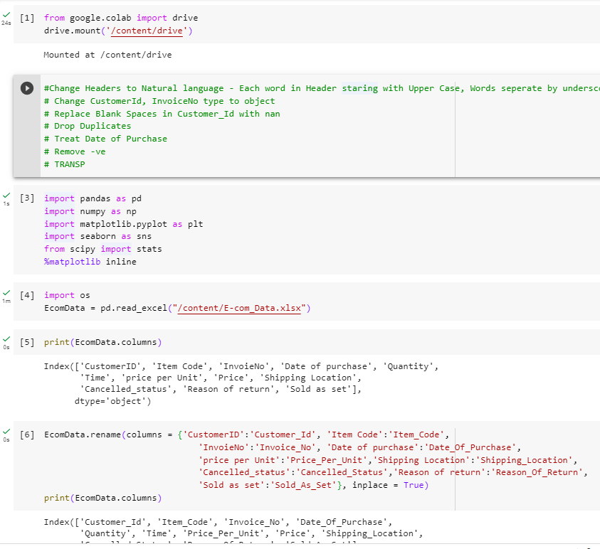
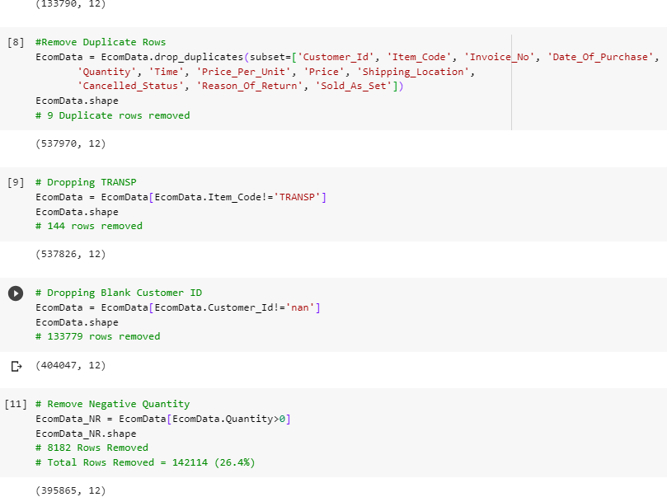
Data Cleaning – For RFM Analysis
Initial Data Shape – (537979,12)
Final Data Shape – (395865,12)
Final Data Shape for RFM Analysis – (395865,4)
Total Rows Removed – 142114 (26.4%)

Slide 8
Data Cleaning – Summary
Particulars | Before Data Cleaning | After Data Cleaning | Taken for Model | Remarks
Unique Customer Ids | 4350 | 4324 | 4324 | 0.6% Customers removed due to data cleaning
First date of available data | 02 December 2016 | 02 December 2016 | 02 December 2016 | No Change
Last date of available data | 19 December 2017 | 19 December 2017 | 19 December 2017 | No Change
Unique count of Date of Purchases | 381 | 381 | 381 | No Change
Invoice No Unique Count | 24929 | 18302 | 18302 | 26.6 % of Unique Invoice Counts removed due to data cleaning
Total Revenue | 116 Cr | 101 Cr | 101 Cr | 13 % Revenue not considered post data cleaning
Item Code |  |  | Dropped | No Role in RFM Calculations. Aggregation not possible.
Quantity |  |  | Dropped | No Role in RFM Calculations.
Time |  |  | Dropped | Recency calculated in days and not in fraction of days.
price per Unit |  |  | Dropped | No Role in RFM Calculations. Aggregation not possible.
Shipping Location |  |  | Dropped | No Role in RFM Calculations. Aggregation not possible.
Cancelled_status |  |  | Dropped | No Role in RFM Calculations. Aggregation not possible. More than 98% of data missing
Reason of return |  |  | Dropped | No Role in RFM Calculations. Aggregation not possible. More than 98% of data missing
Sold as set |  |  | Dropped | No Role in RFM Calculations. Aggregation not possible. More than 98% of data missing
Data Shape | 537979 X 12 | 395865 X 4 | 395865 X 4 | 73.5 % of Total Data considered for K-Mean Clustering.

Slide 9
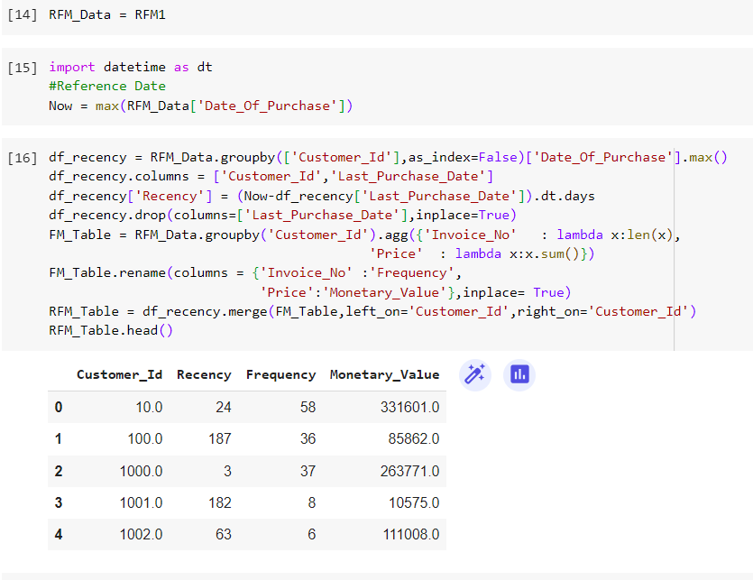
EDA – RFM Segments
Recency – Number of days between reference date, i.e. Last Date in Data, and date of last purchase of each customer. Reference Date – 19th Dec 2017
Frequency – The number of orders (different invoice) for each customers.
Monetary Value – Total Revenue from each Customer.

Slide 10
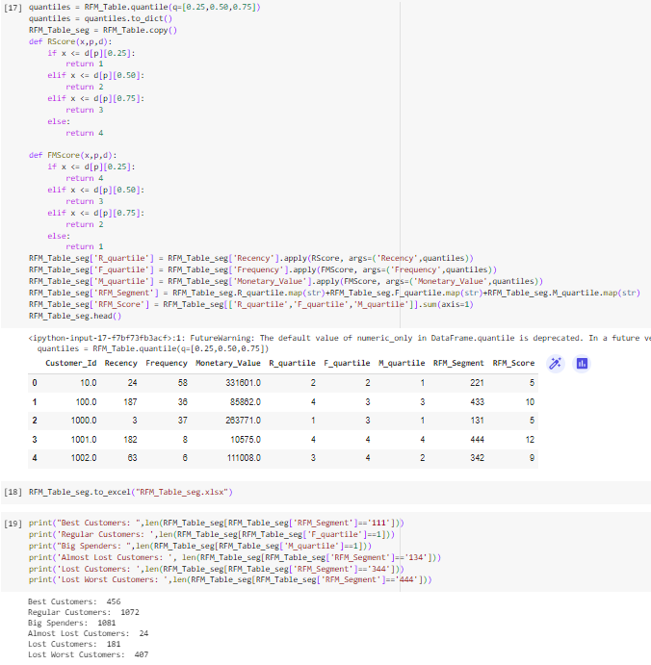
EDA – RFM Segments
Score each of R, F & M on 1-4 scale, using quantile method.
Best Recency Score – 1 : Purchased very recently.
Best Frequency Score – 1 : Highest No of Invoices generated.
Best Monetary value Score – 1 : Highest Revenue
RFM segment is concatenation of three scores.
RFM score is sum of three individual scores.

Slide 11

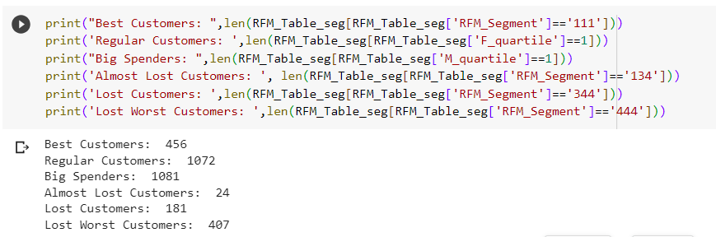
EDA – RFM Segments & Business Strategy
Best Customers – RFM segment ‘111’
Market New Products
Loyalty Program
Big Spenders – Highest Monetary Score – ‘1’
Market expensive Products.
Incentivize for more purchase.
Almost Lost – RFM segment ‘134’
Intensive retention strategy.
Aggressive price incentive
Lost – RFM segment ‘344’ & ‘444’
Strategy to re-acquire.
Don’t spend much

Slide 12
RFM Segmentation – K-Mean Clustering
Steps:
Check Skewness
Remove skewness – log Transformation
Outlier Treatment – Winsorizer (Capping Method: Gaussian)
Find Optimal K – Elbow Curve Visualization Method
K- mean model building – Using RapidMiner

Slide 13
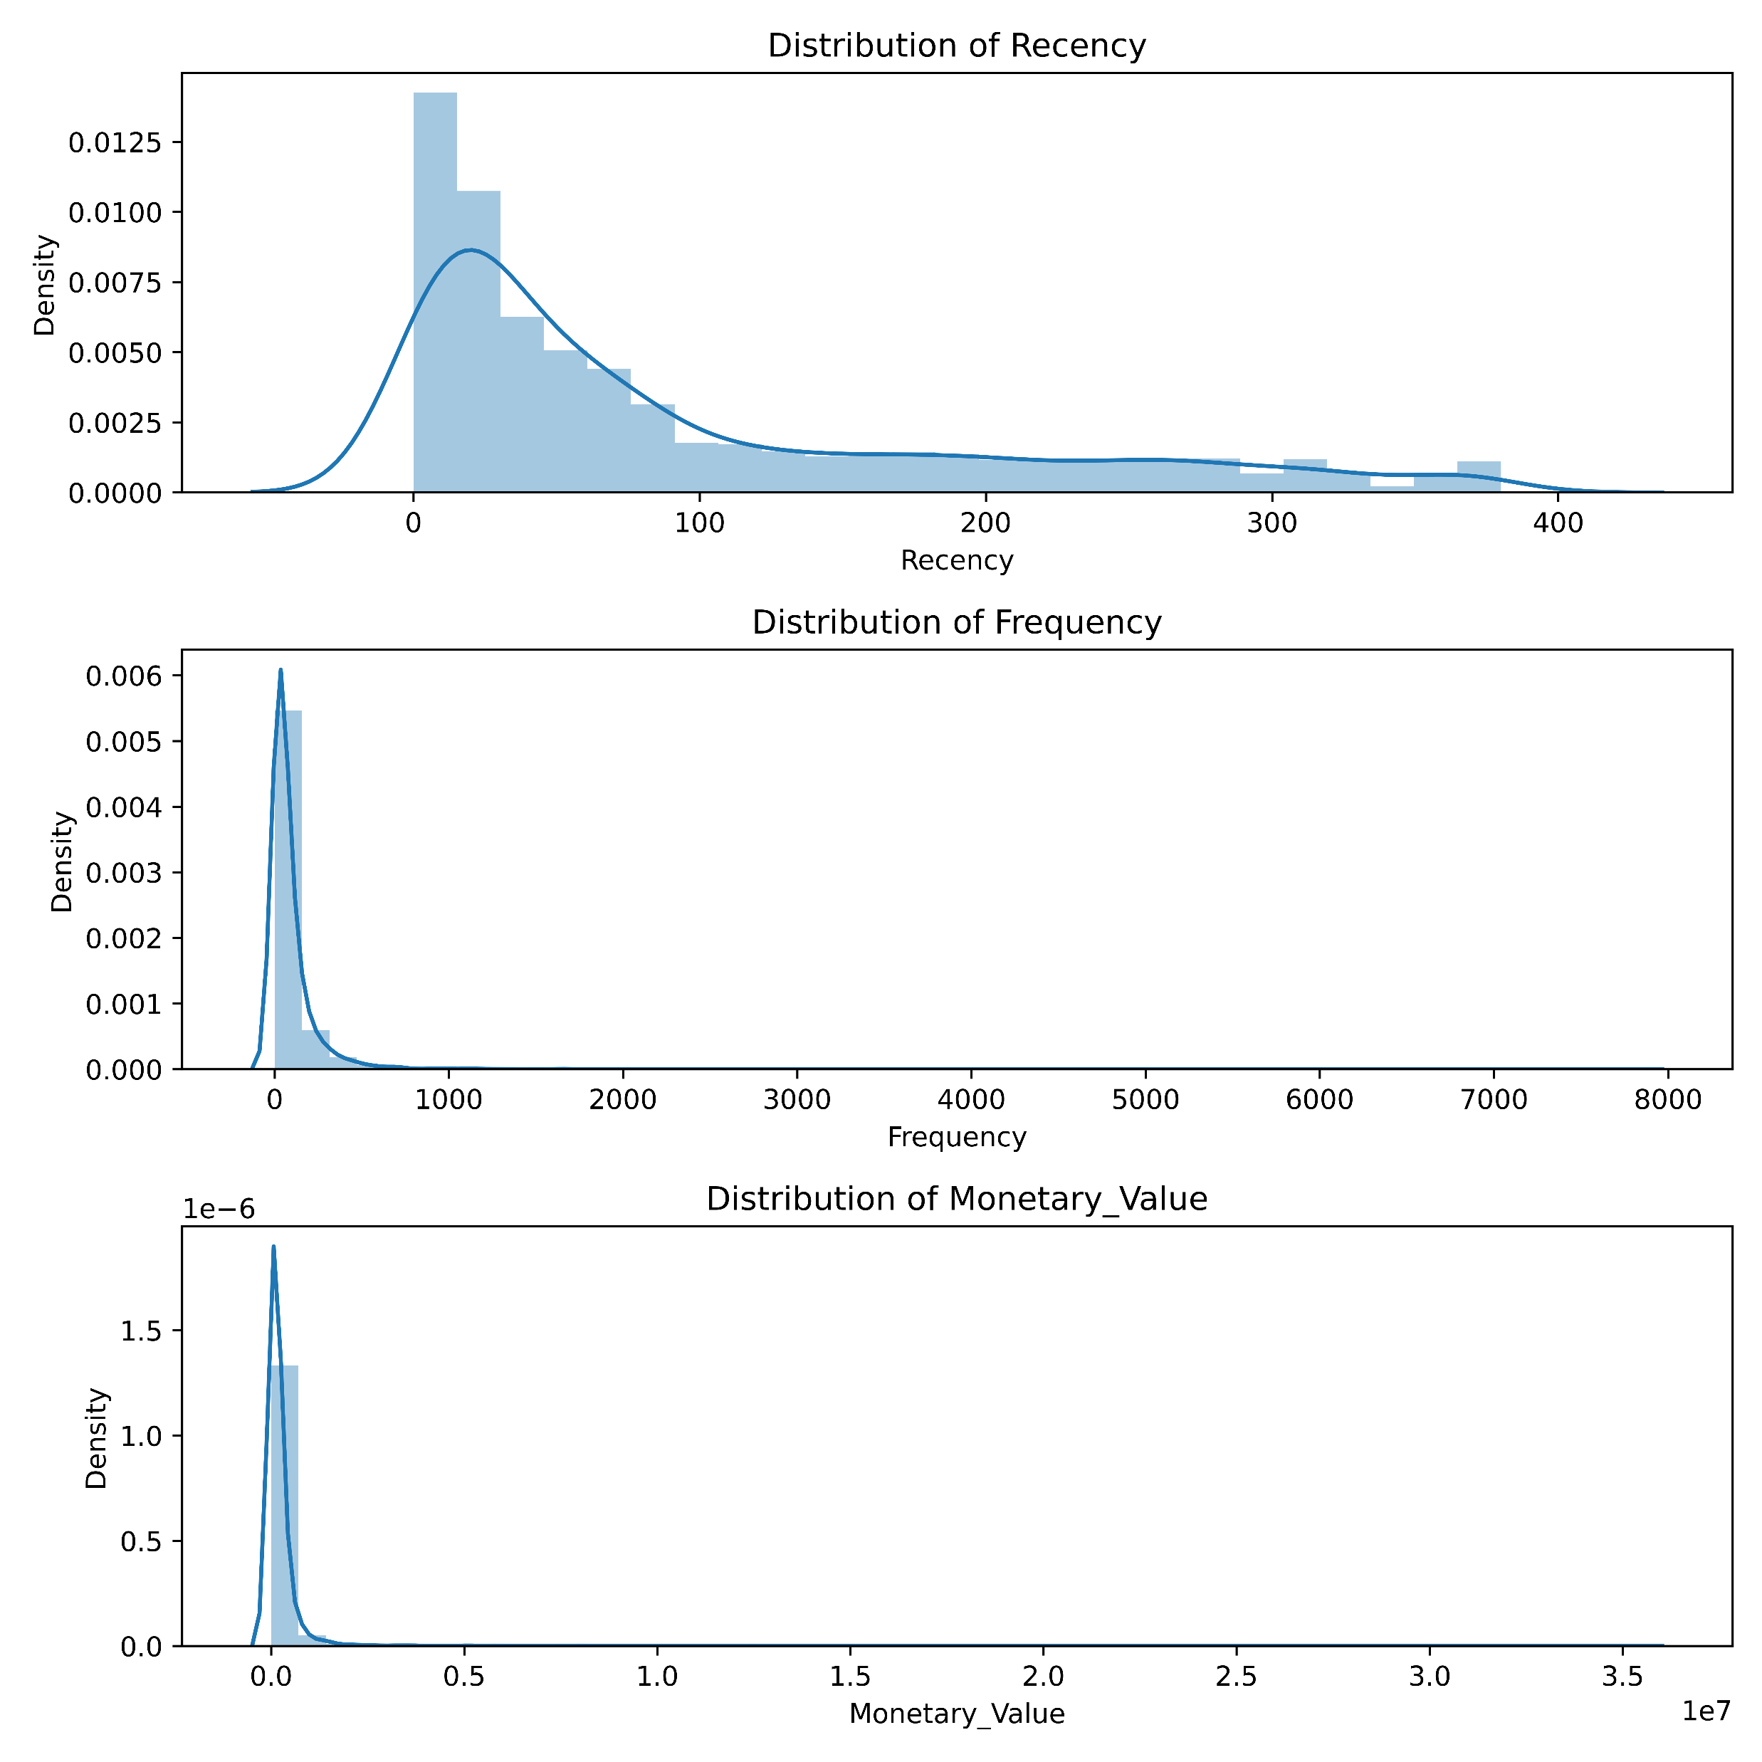
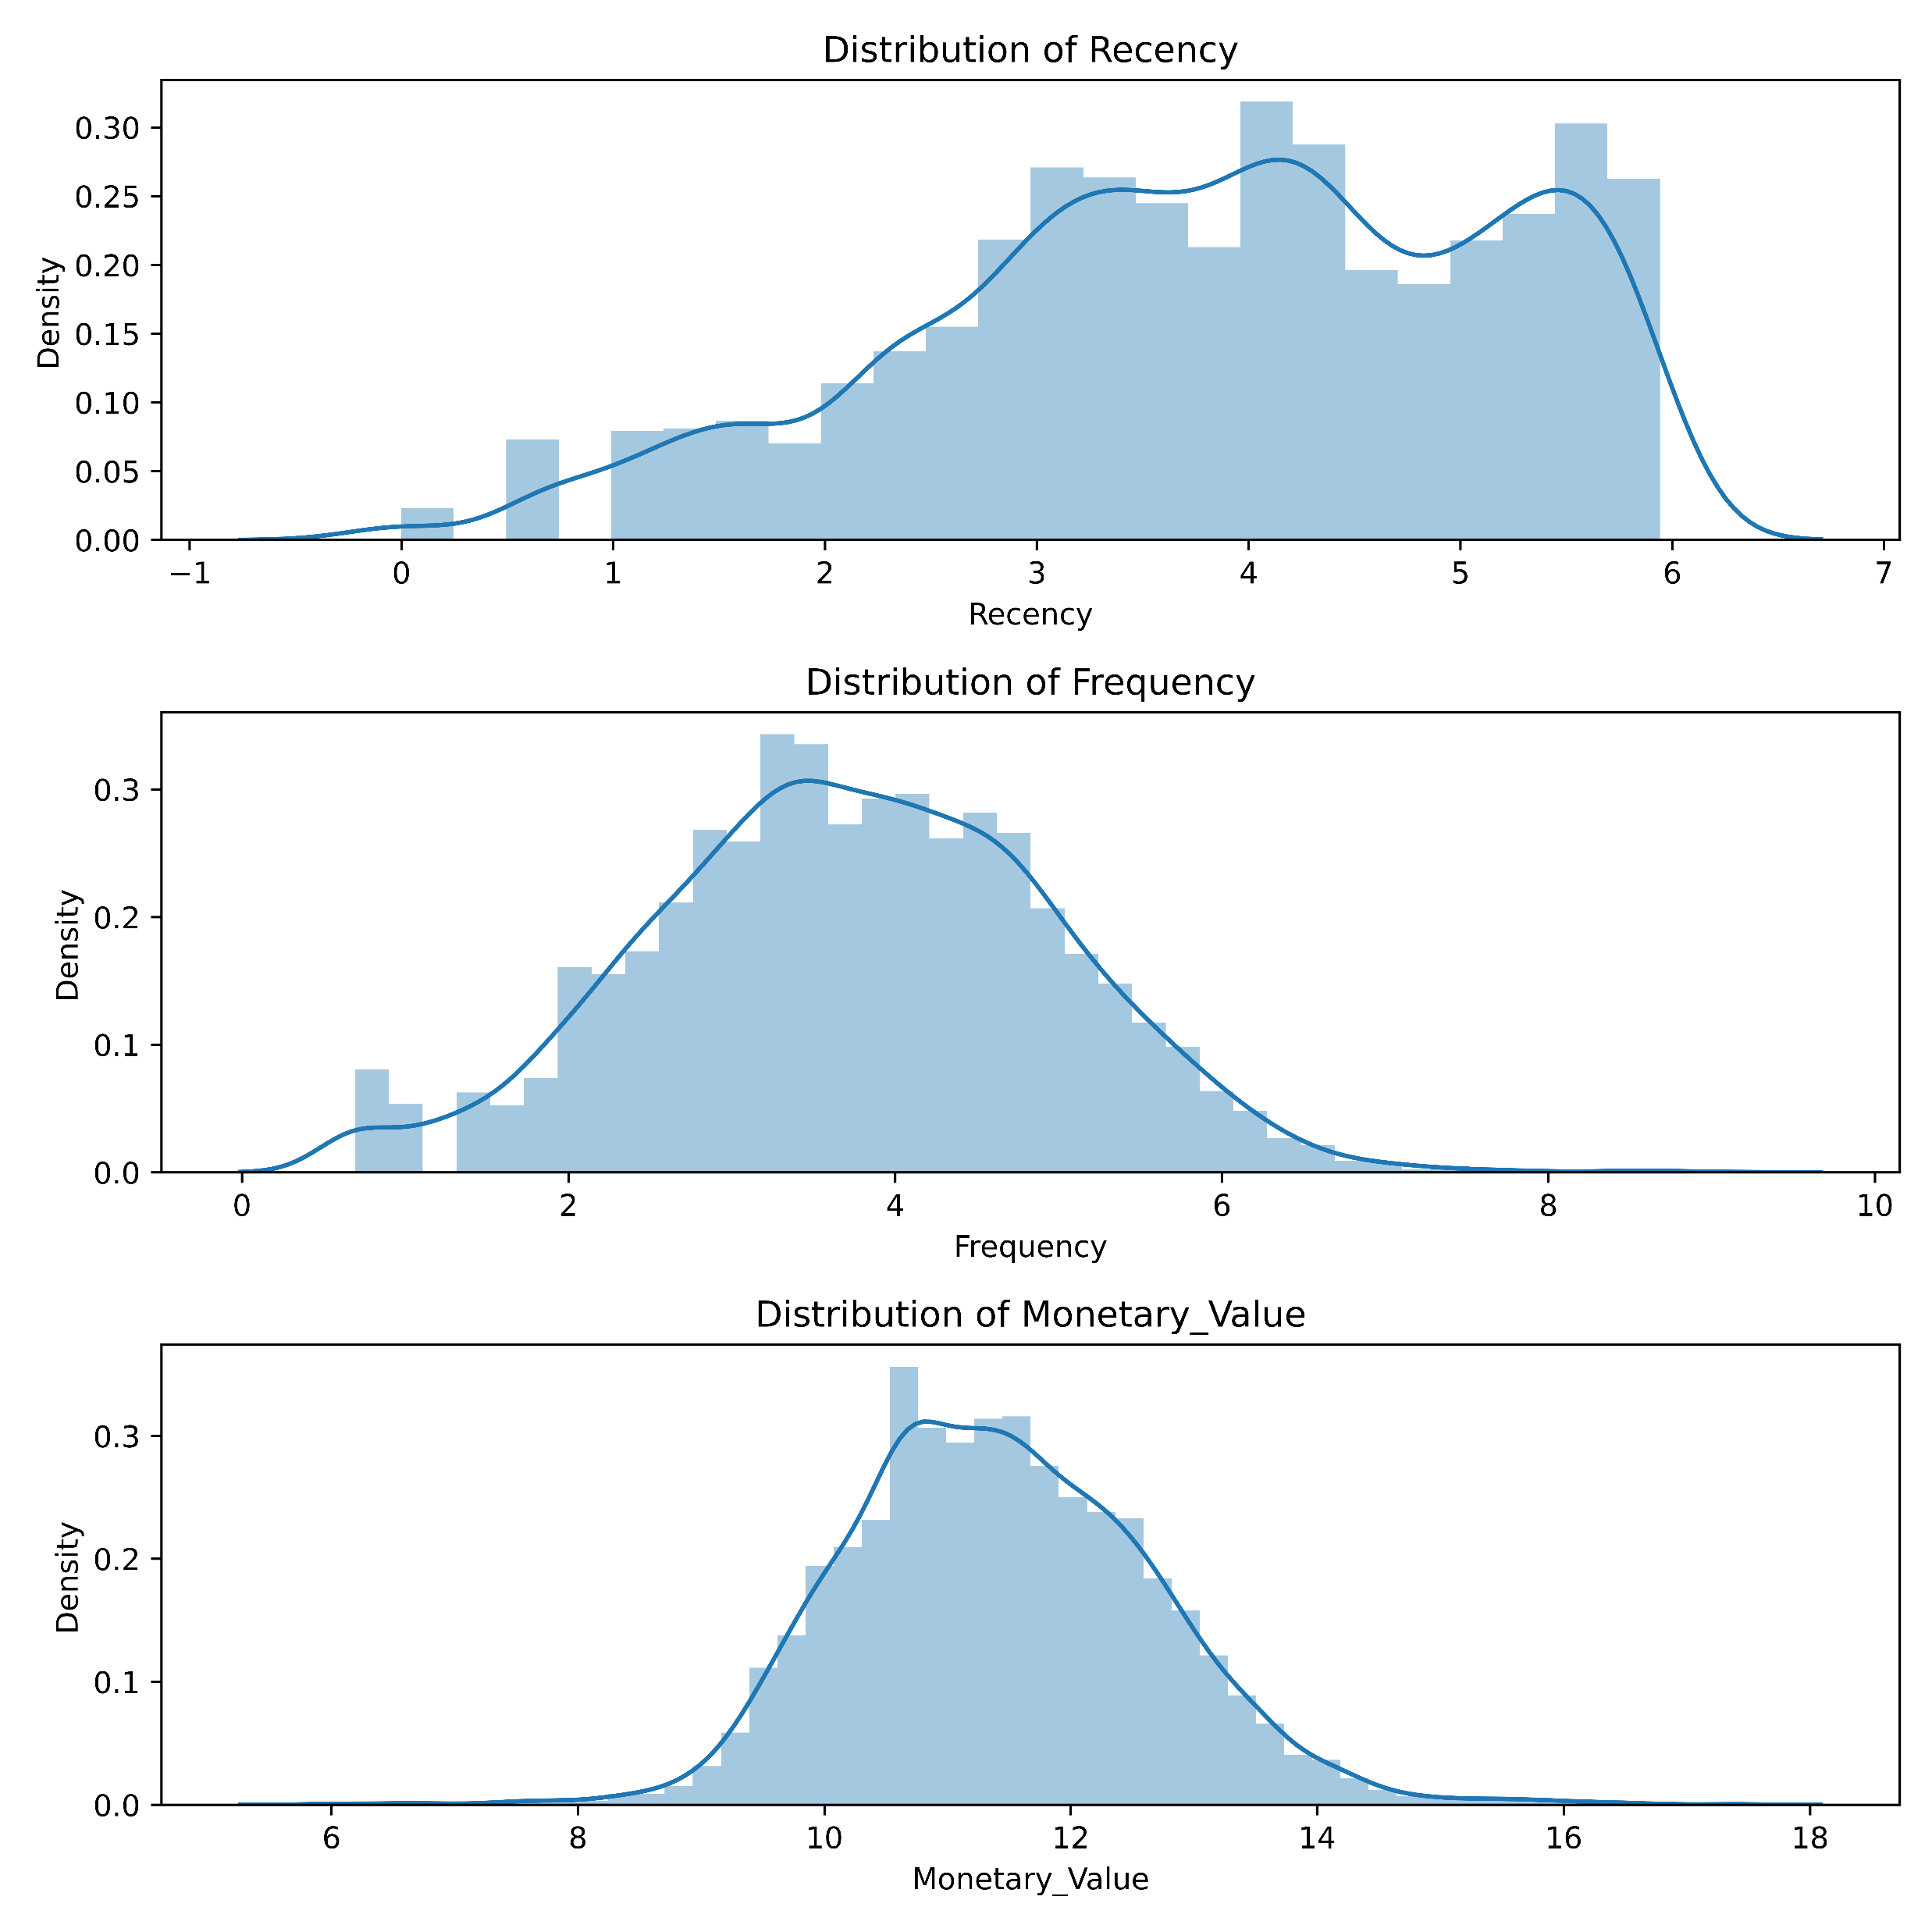
RFM Segmentation – Skewness Check and log Transformation
BEFORE
After
K-means gives the best result under the following conditions:
Data’s distribution is not skewed.
Data is standardized.
Log Transformation works best on Right Skewed Data

Slide 14
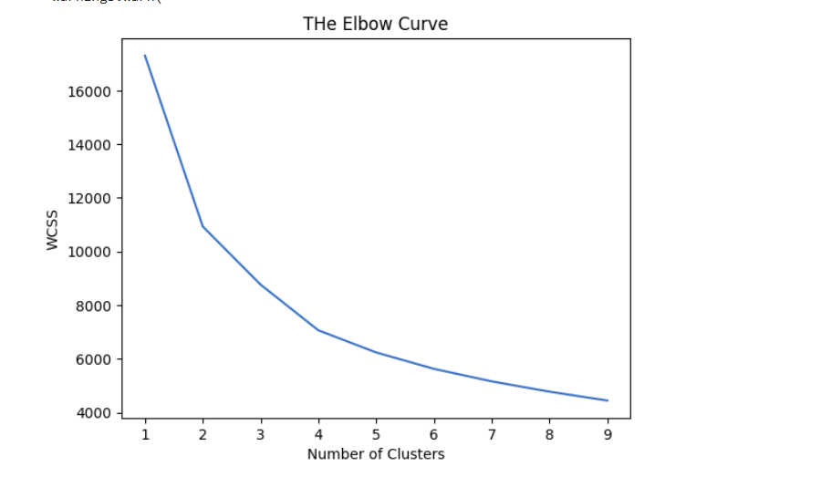
Optimal K – Elbow Curve Visualization Method
Among 2, 3, and 4, as point of inflection, 4 has been selected as optimal K.
3 being odd has been neglected and higher of 2, 4 is taken.

Slide 15
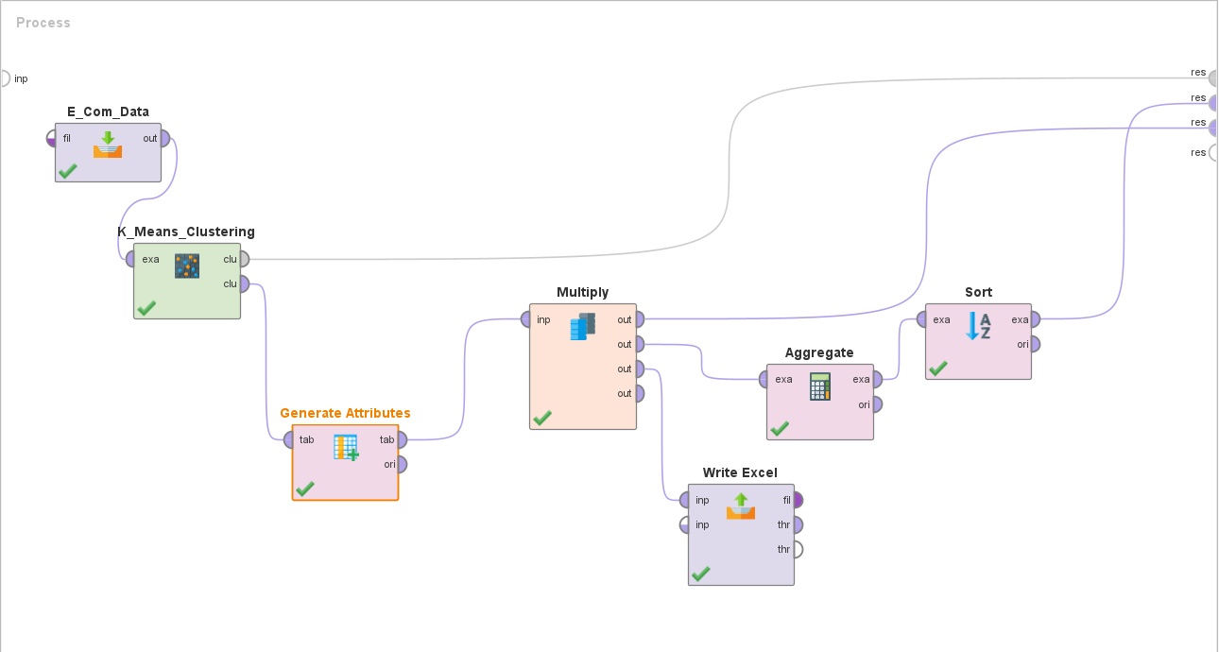
K-Means Clustering with RapidMiner
Added scaled dataset using ReadExcel operator.
Applied K-means clustering with K = 4 (value from Elbow curve) and 50 iterations.
Generated attribute to segment the customers in different categories.
Aggregated and sorted the customer segments.
Received Output of Segmentation Excel format.

Slide 16
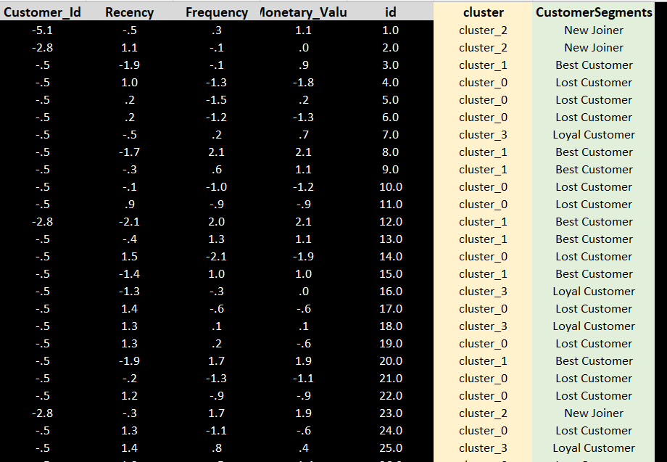
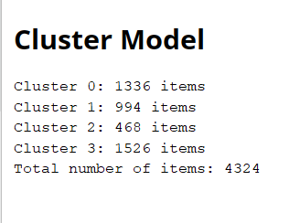
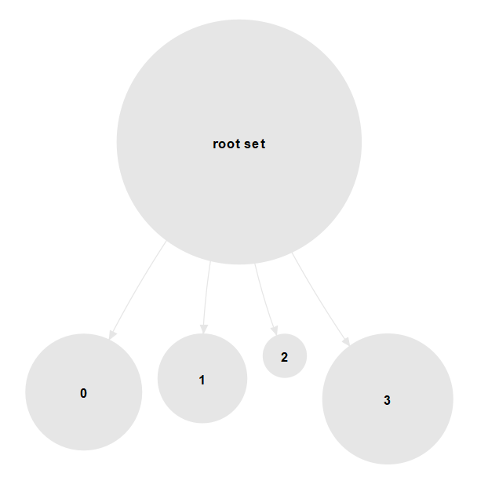
Output of Customer Segmentation

Slide 17
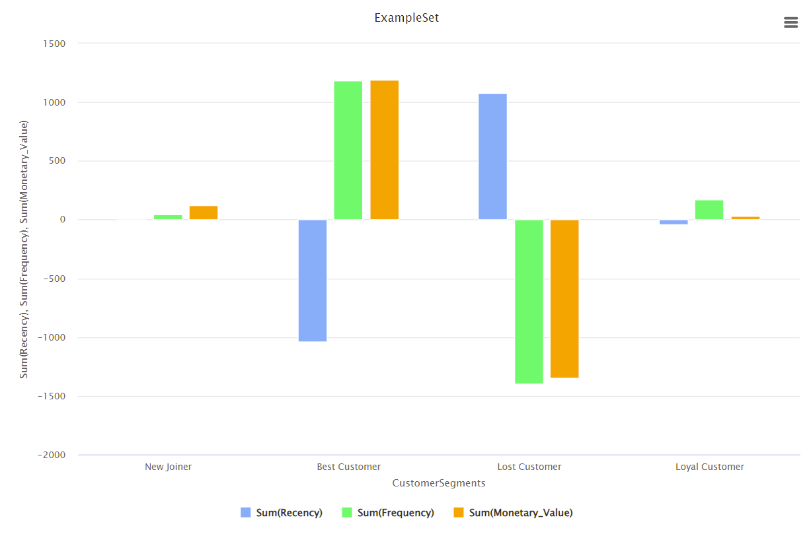
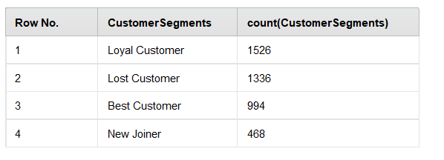
Cluster analysis and Business Insight
Cluster Label 1 –
Customers with most recent purchase, High frequency, High Monetary value.
Best Customers
Cluster Label 0 –
Customer with highest value of Recency, i.e., least recent purchase, lowest frequency, lowest monetary value.
Lost Customers
Customer Label 2 –
Average Recency, New Customers, Average Monetary Value
New joiners and the bulk lot.
More data on first purchase date required to analyze further
Need strategy for converting from Label2 to Label1
Customer Label 3 – Loyal Customers

Slide 18
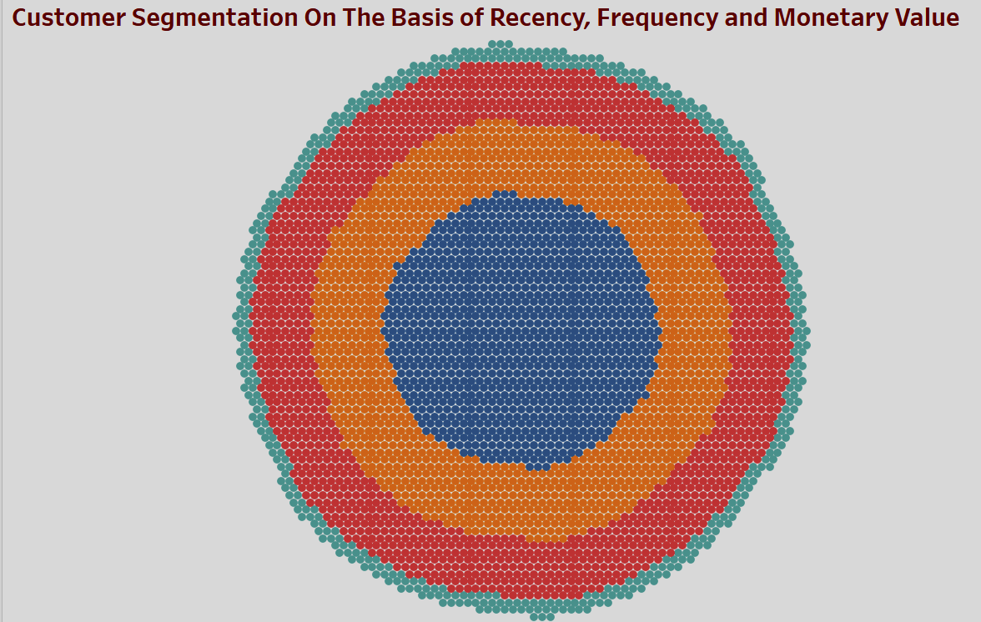
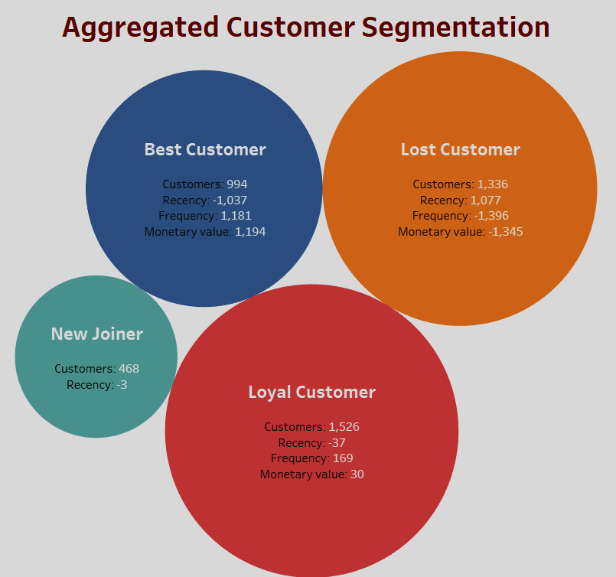
Visualizations with Tableau

Slide 19
Business Suggestions
Cluster Type | Count | RFM Characteristic | Strategy
Best Customer | 994 | Dream customers, bought recently, buys frequently and buys big. Create positive word of mouth for brand amongst their circle. | They can become early adopters for new products and will help in promoting the brand.
Bulk / New Joiners? | 468 | Recent Visitors but frequency might be low because they are new customers. Highest bulk and average monetary value, as they might be still in trial phase | Offer membership or loyalty programs on high value items or recommend related products to upsell them.
Loyal Customer | 1526 | This segment is the bread and butter for the business as it consist of customers those have clear and positive view of the brand. | Emphasize customer relationship management to strengthen the engagement.
Lost Customers | 1336 | Poorest performers of our RFM model. They might have gone with our competitors for now. | Survey to be done on reason of being churned. They require a different activation strategy to win them back.

Slide 20
Closing notes
Knowing the customers as group / segments is cheaper and effective method for marketers to know their clients.
Knowing the clients helps companies to invest effectively in marketing activities like, product promotion, rewards for retention, incentives for more purchase, launch of trial product etc.
Hence Segmenting the customers helps in maximizing the return on marketing / business development expenses.
RFM is a data-driven customer segmentation technique that allows marketers to take tactical decisions. It empowers marketers to quickly identify and segment customers into homogeneous groups with similar traits and target them with differentiated and personalized marketing strategies.

Slide 21
Thank You
We would like to express our gratitude towards team members and mentor for all their support and guidance.
Thank you all for your attention and time.

